Slide 1

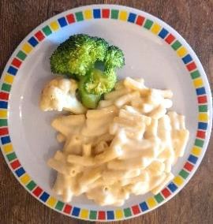

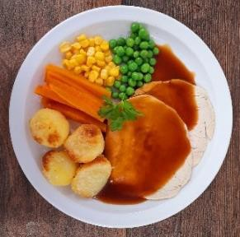
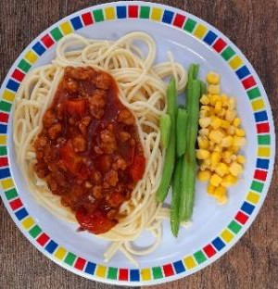
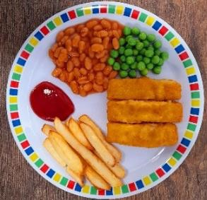
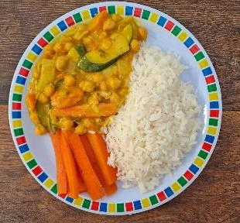
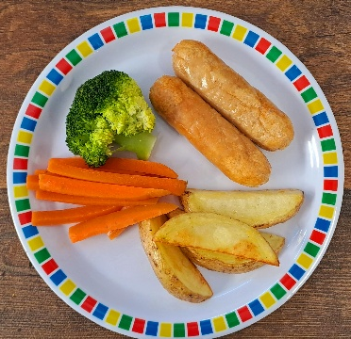
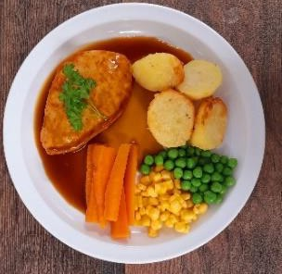
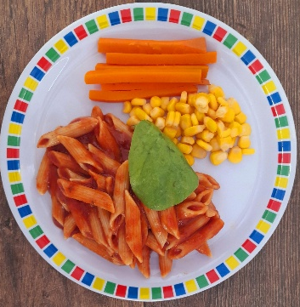
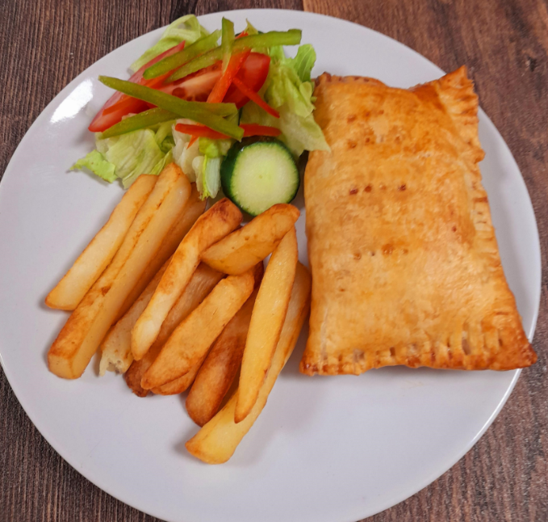
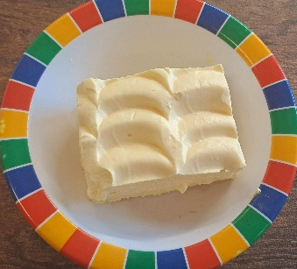
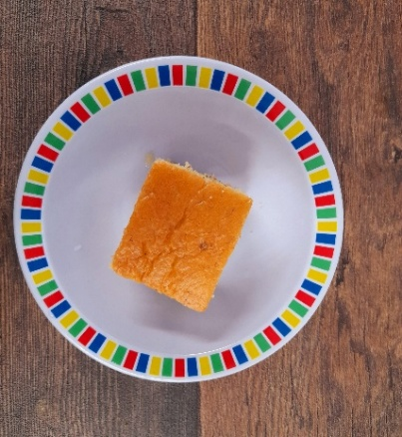
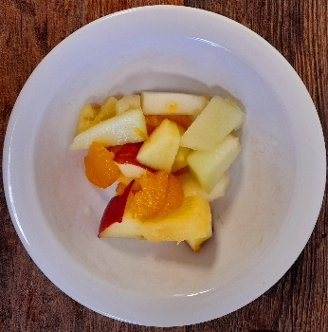
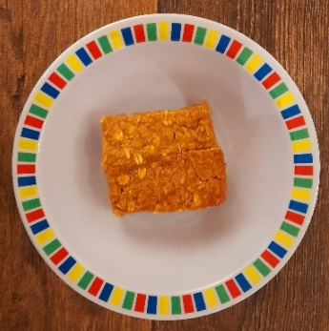
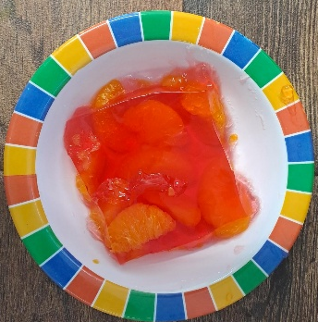
WEEK ONE
 | MONDAY | TUESDAY | WEDNESDAY | THURSDAY | FRIDAY
OPTION 1 | Macaroni Cheese | Phat Pasty Pork Sausage Roll with Potato Wedges | Roast Chicken, Stuffing, Roast Potatoes & Gravy | Spaghetti Bolognaise | Fish Fingers or Salmon Fish Fingers with Chips & Ketchup
OPTION 2 | Chickpea Curry and Rice | Quorn Cumberland Sausage with Potato Wedges | Roast Quorn, Roast Potatoes & Gravy | Tomato & Vegetable Pasta | Cheese & Bean Pasty with Chips & Tomato Ketchup
DESSERT | Banana Mousse | Orange Drizzle Cake | Fruit Platter | Apple Flapjack | Jelly with Mandarins
*VEGETABLES AND SIDES MAY DIFFER THAN THOSE SHOWN

Slide 2

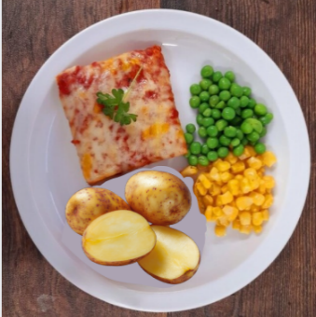
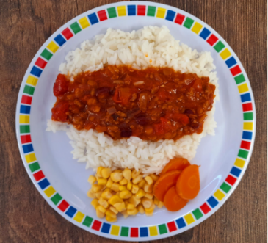
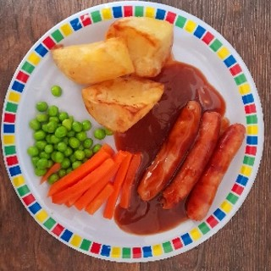
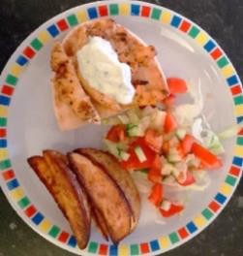
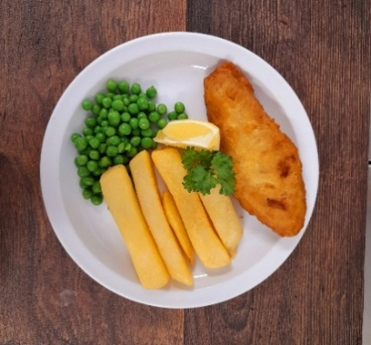
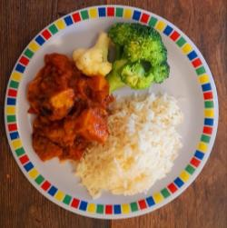
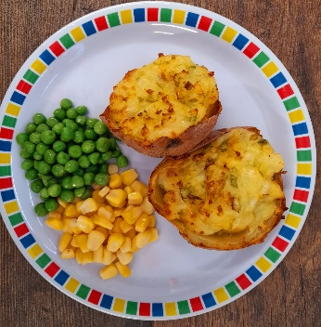
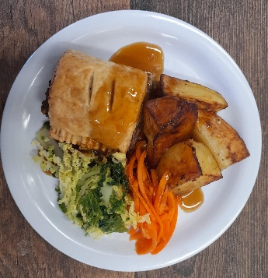
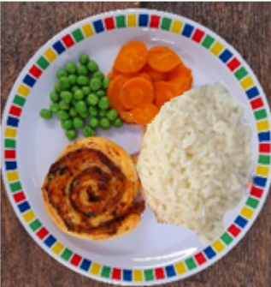
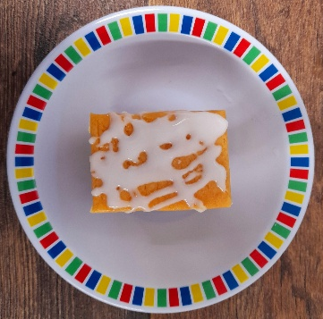
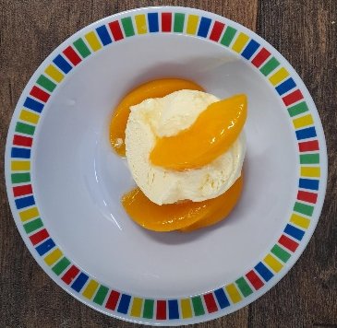
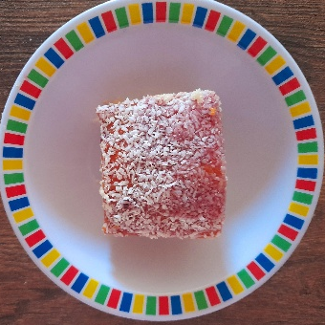

WEEK TWO
 | MONDAY | TUESDAY | WEDNESDAY | THURSDAY | FRIDAY
OPTION 1 | Cheese & Tomato Pizza with New Potatoes | Beef Chilli with Rice | Roast Pork Sausage, Roast Potatoes & Gravy | Greek Chicken Pitta with Herby Rice & Tzatziki | Battered Fish with Chips & Tomato Ketchup
OPTION 2 | Lentil and Sweet Potato Curry with Rice | Loaded Jacket with Spring Onion & Cheese or Tomato Pasta | Vegetarian Wellington, Roast Potatoes & Gravy | Spinach & Cheese Whirl with Herby Rice & Tzatziki | Quorn Sausage with Chips & Tomato Ketchup
DESSERT | Iced Vanilla Sponge | Peaches & Ice Cream | Freshly Chopped Fruit Salad | Jam & Coconut Sponge | Oaty Cookie
*VEGETABLES AND SIDES MAY DIFFER THAN THOSE SHOWN

Slide 3

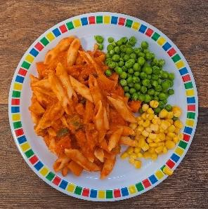
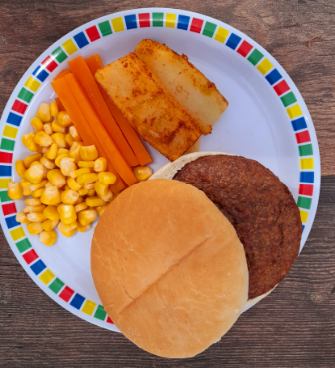
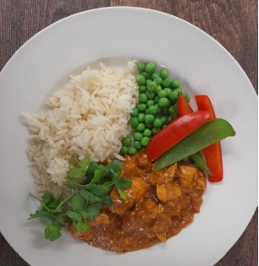
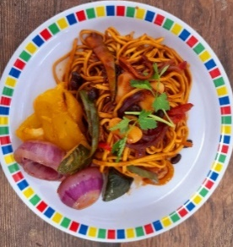
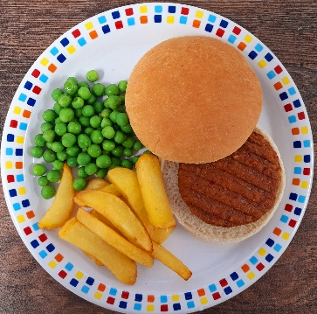
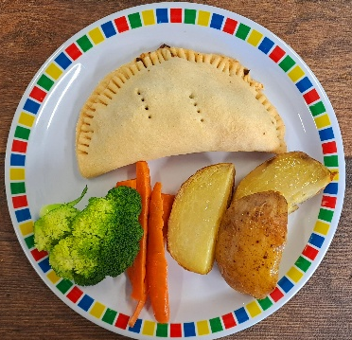
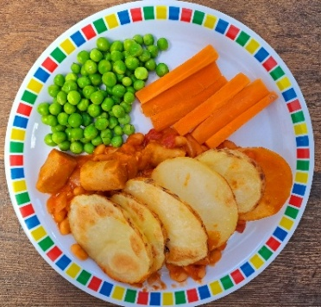
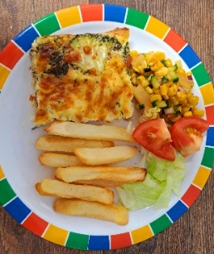
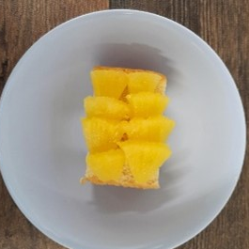
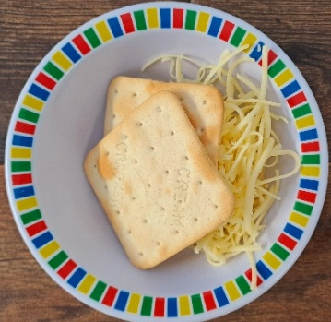
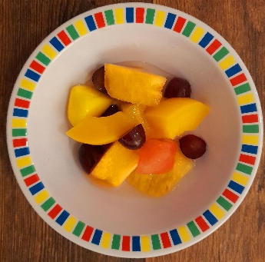
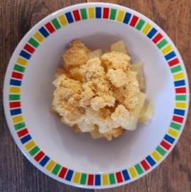
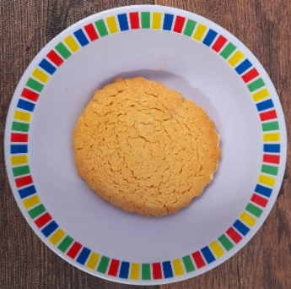
WEEK THREE
 | MONDAY | TUESDAY | WEDNESDAY | THURSDAY | FRIDAY
OPTION 1 | Tomato Pasta | Beef Burger with Potato Wedges & Tomato Sauce | Roast Chicken with Roast Potatoes & Gravy | Chef Shilpa’s Chicken Korma with Rice | Fish Fingers with Chips & Tomato Ketchup
OPTION 2 | Chinese Vegetable Noodles | Quorn Burger with Potato Wedges & Tomato Sauce | Vegetable Pasty, Roast Potatoes & Gravy | Cowboy Sausage and Bean Hotpot | Cheesy Broccoli Frittata with Chips
DESSERT | Pineapple Upside Down Cake | Cheese & Crackers | Fruit Medley | Strawberry & Apple Crumble with Ice Cream or Cream | Vanilla Shortbread
*VEGETABLES AND SIDES MAY DIFFER THAN THOSE SHOWN

