Slide 1


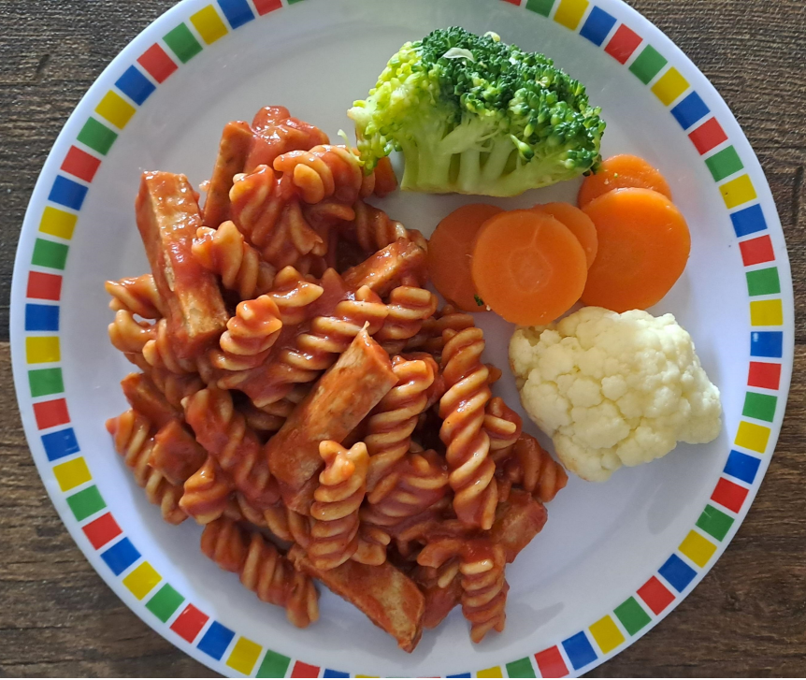
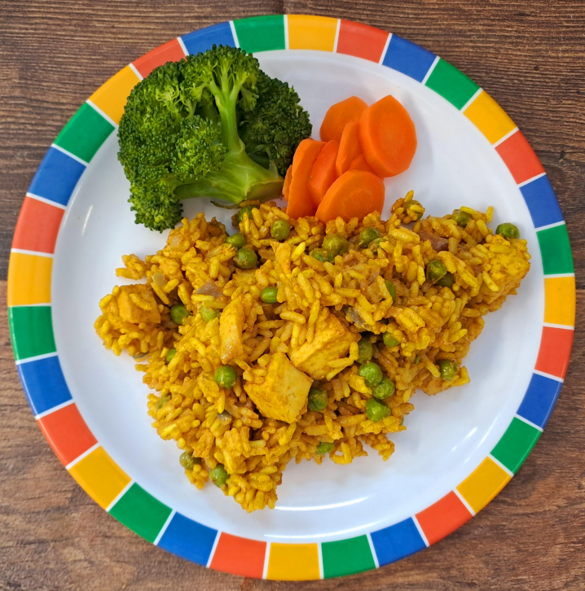
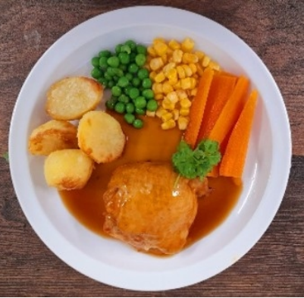

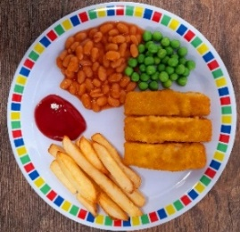
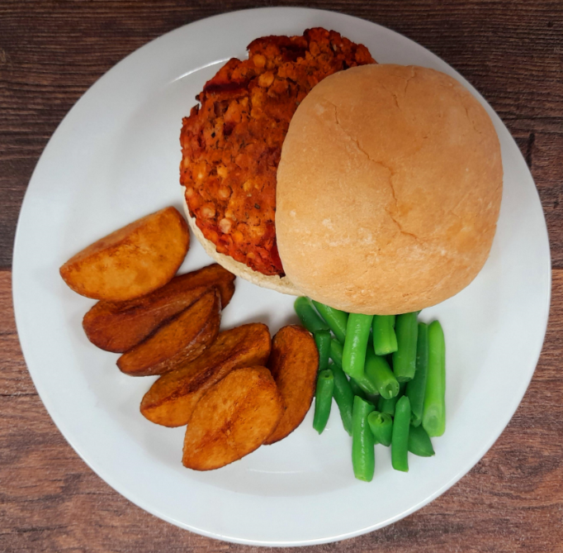
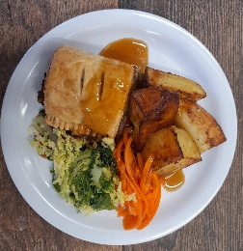

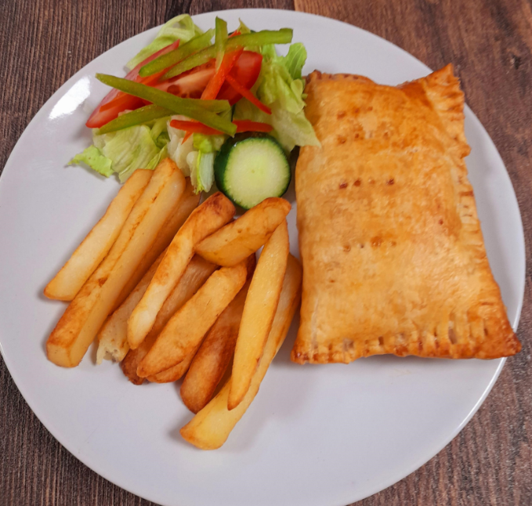

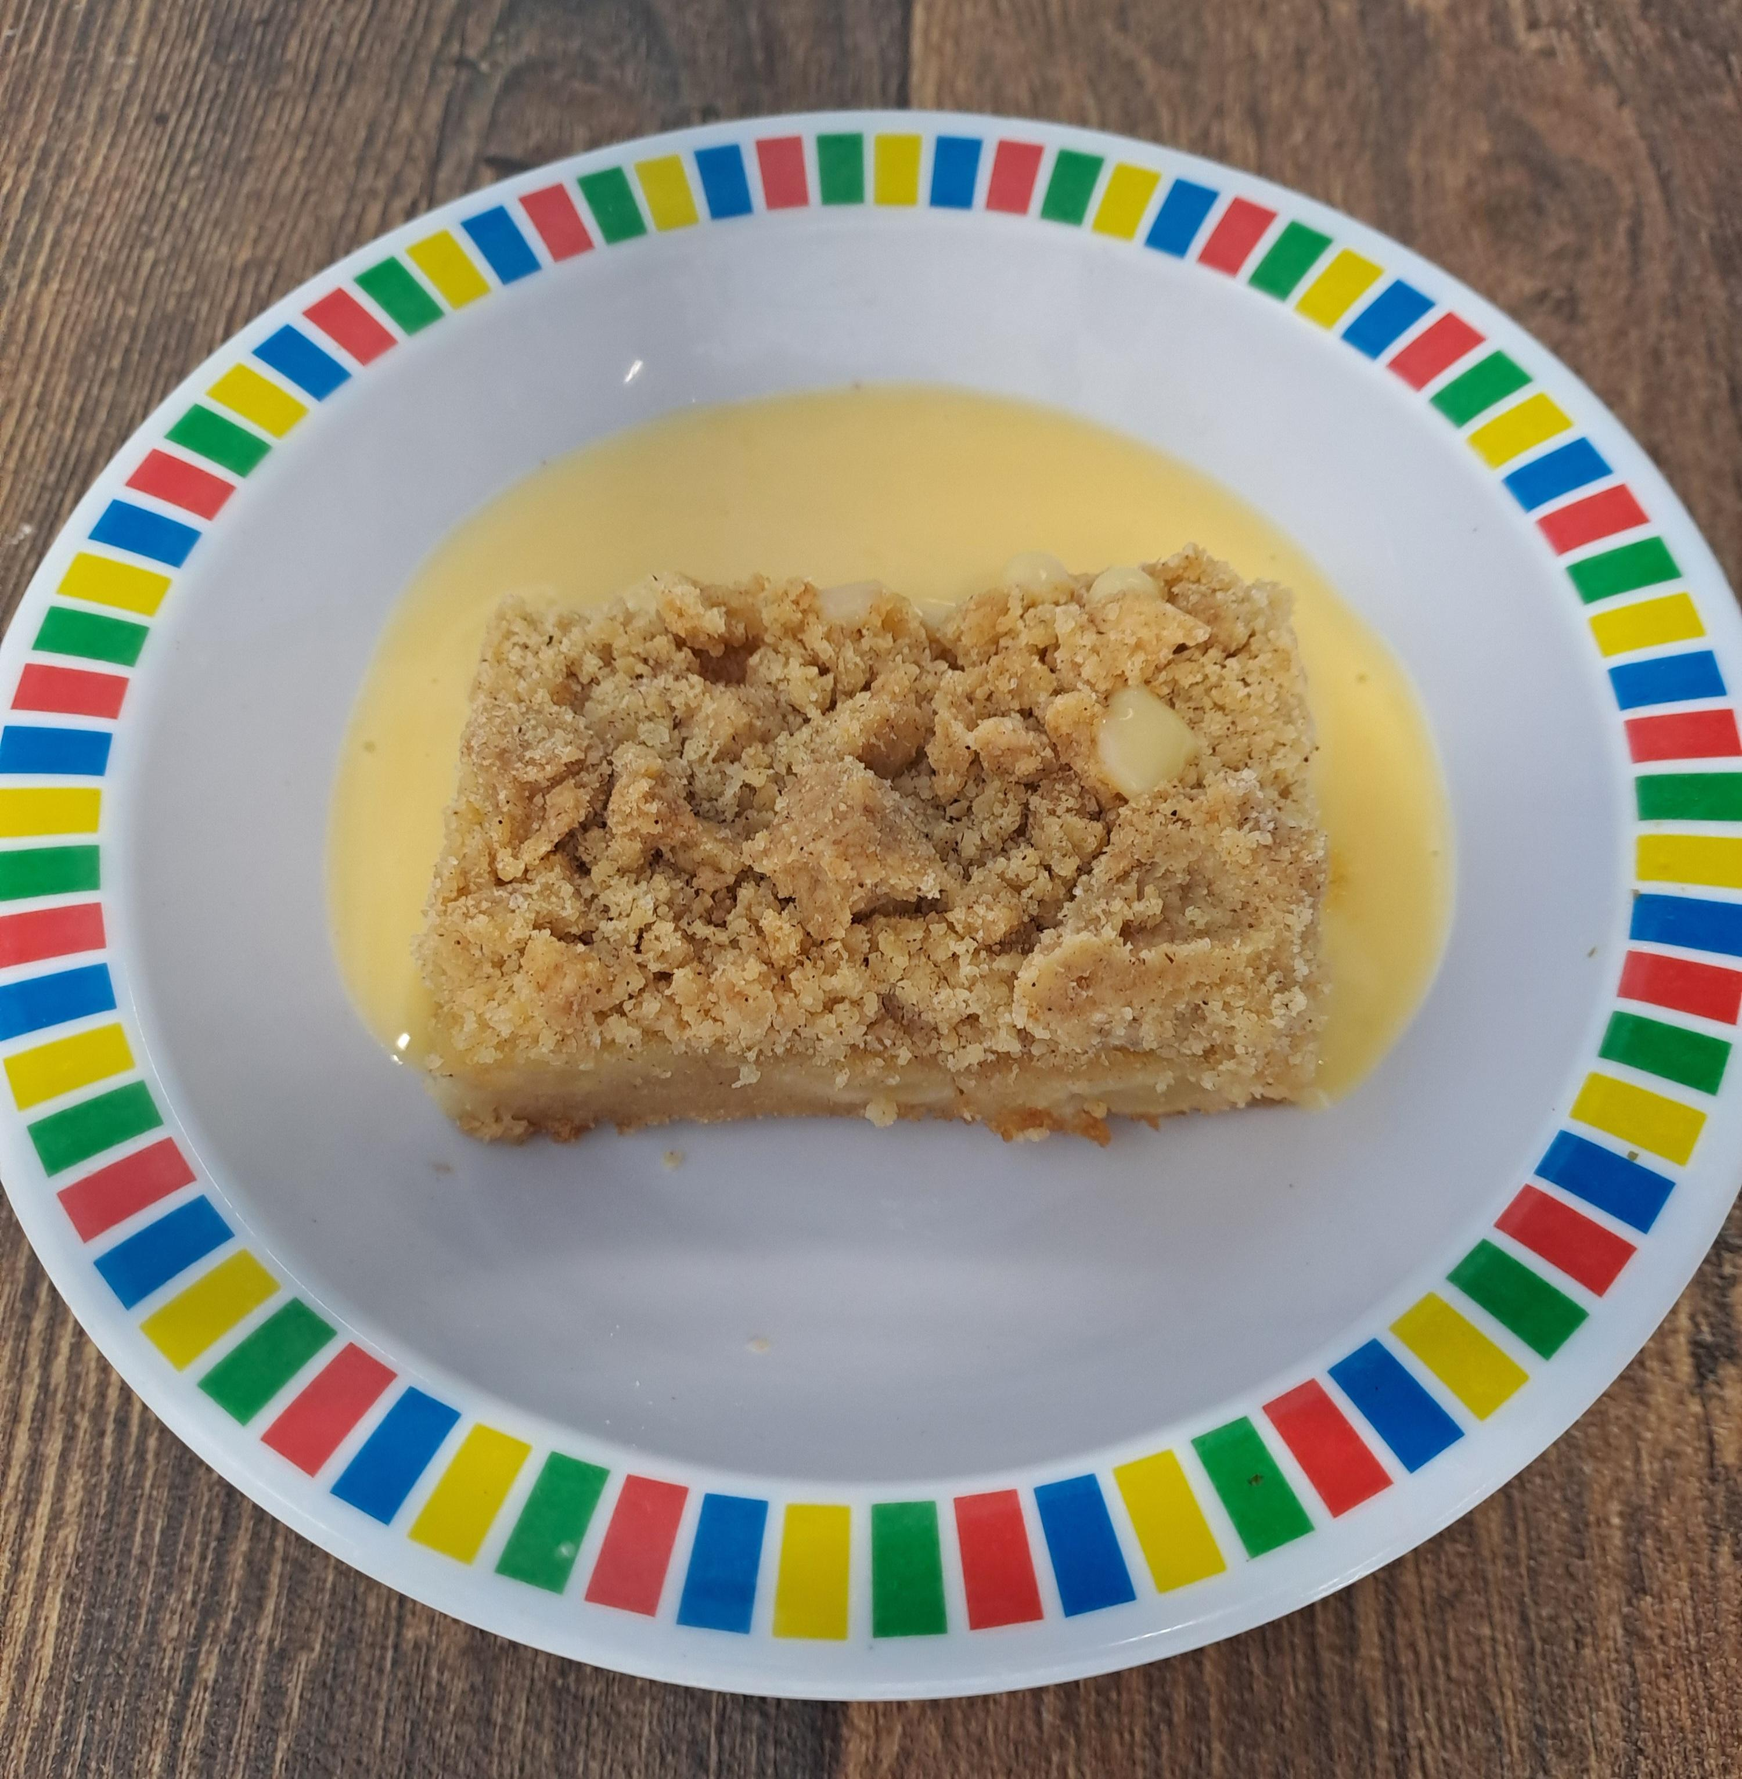




Autumn Winter 2025 2026
Roast Chicken with Stuffing, Roast Potatoes and Gravy
Salmon or Pollock Fish Fingers with Chips & Tomato Sauce
BBQ Veggie Sausage Pasta with Garlic Bread | Curried Chicken with Rice
Beef Lasagne with Garlic Bread
27.10.2025
17.11.2025
08.12.2025 12.01.2026 02.02.2026 02.03.2026 23.03.2026
Autumn Vegetable Lasagne | Veggie Burger in a Bun with Potato Wedges | Vegetarian Wellington with Roast Potatoes and Gravy | Potato & Courgette Layer Bake | Cheese and Bean Pasty with Chips and Tomato Ketchup
Cheese and Crackers | NEW Apple Crumb Cake with Custard | Fruit Medley | Syrup Sponge & Custard | Jelly with Mandarins

Slide 2
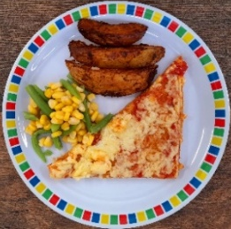
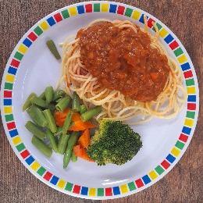
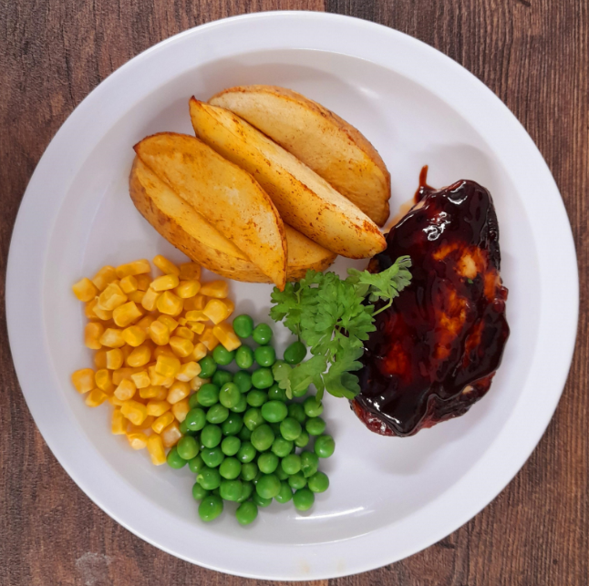
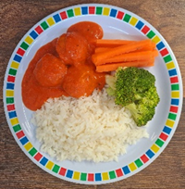

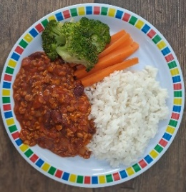
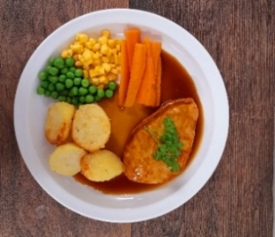
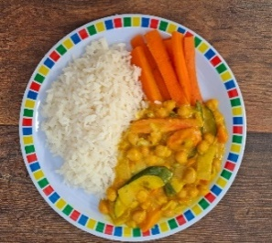
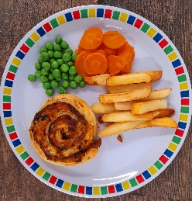
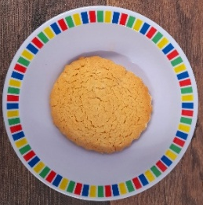
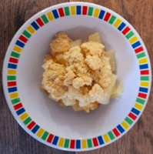

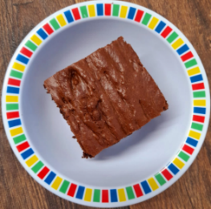
Autumn Winter 2025 2026
Classic Cheese and Tomato Pizza with Wedges | Spaghetti Bolognaise
Beef Meatballs in Tomato Sauce with Rice
Breaded Fish or Fish Fingers with Chips and Tomato Sauce
BBQ Chicken with Seasoned Potatoes and Sweetcorn Salsa
03.11.2025
24.11.2025
15.12.2025 19.01.2026 09.02.2026 09.03.2026 30.03.2026
Mild Mexican Chilli with Rice | Vegan Spaghetti Bolognaise | BBQ Quorn with Seasoned Potatoes and Sweetcorn Salsa | Creamy Chickpea and Coconut Curry with Rice | Cheese Whirl with Chips and Tomato Sauce
 |  |  | Sticky Toffee Apple Crumble with Custard | Vanilla Shortbread
NEW Gingerbread Cookie
Chocolate and Beetroot Brownie with Chocolate Sauce
Fruit Salad

Slide 3
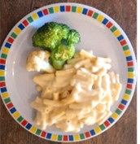
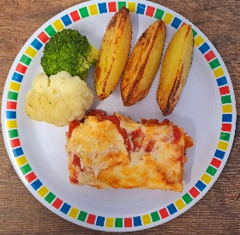
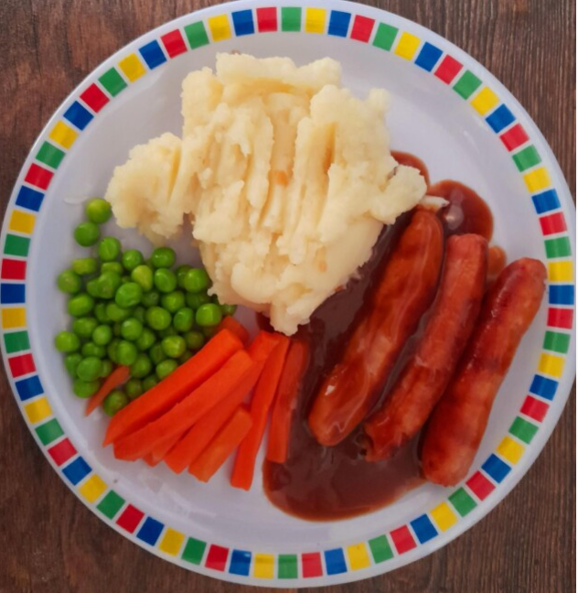
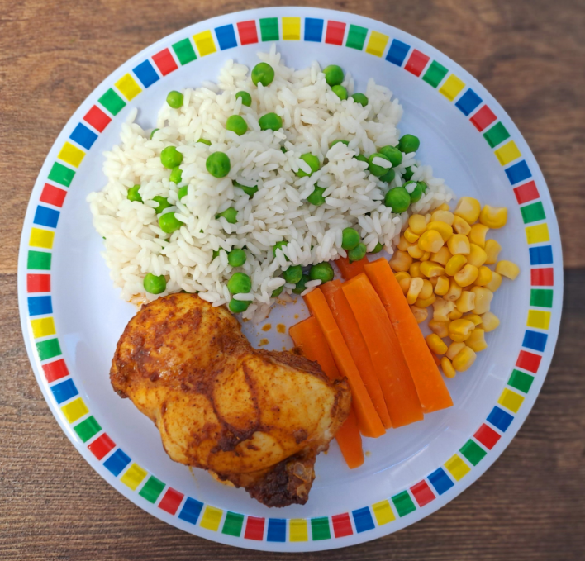
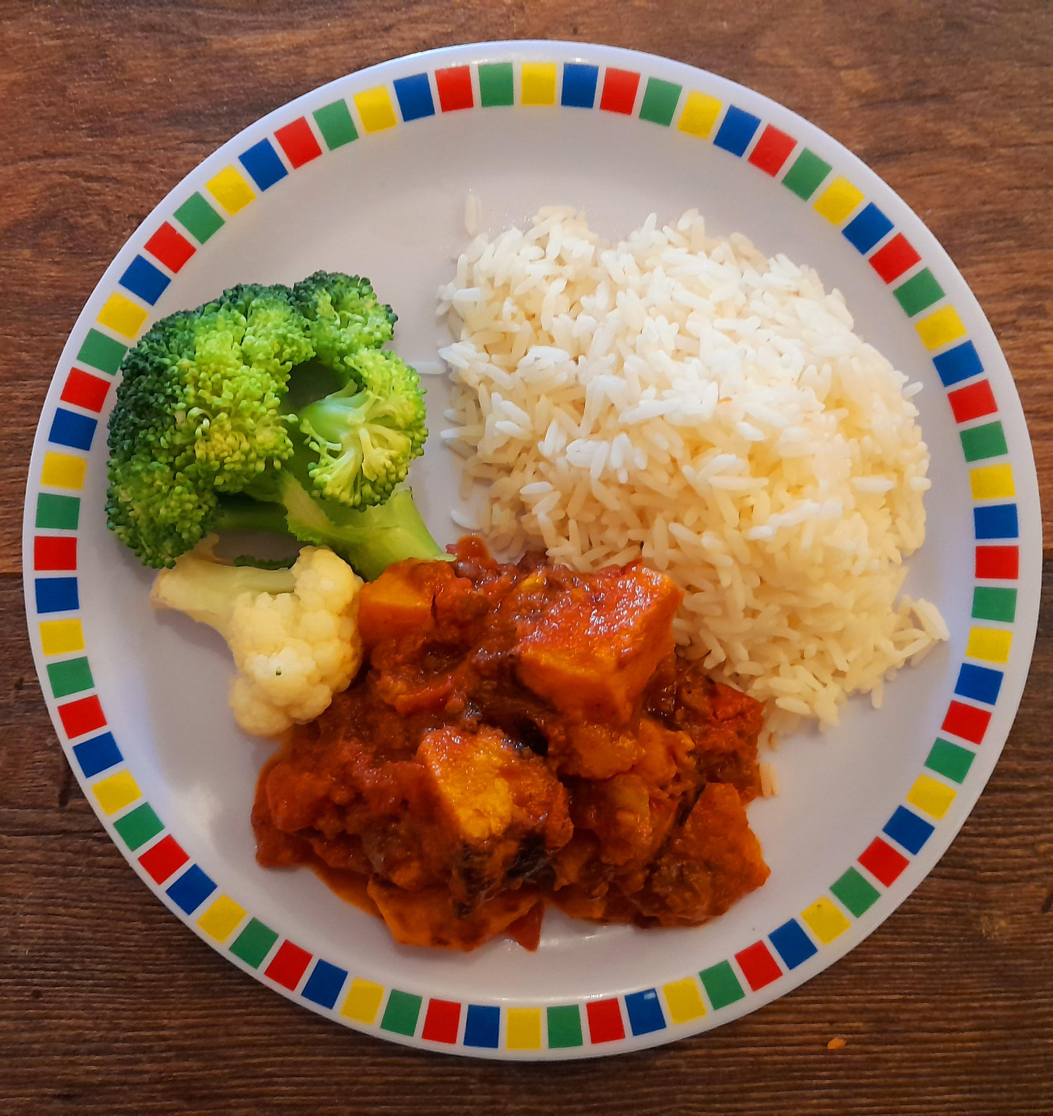
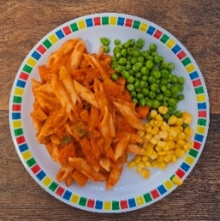

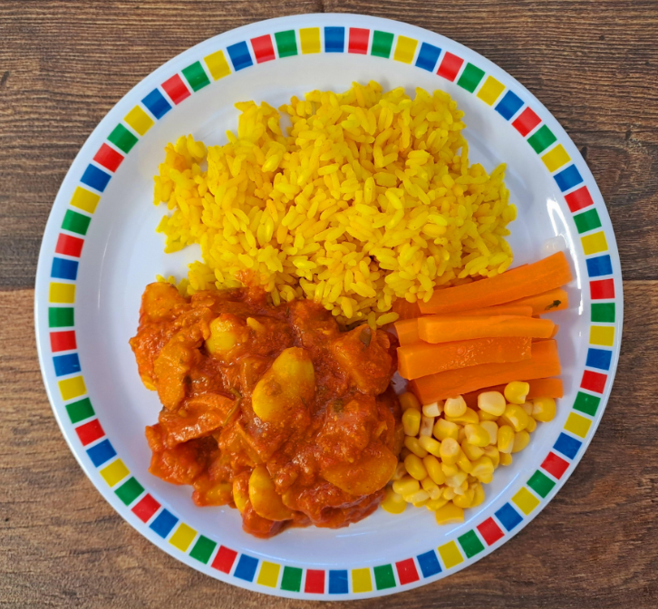




Autumn Winter 2025 2026
Macaroni Cheese |  | Sausage with Roast Potatoes and Gravy | Mild Caribbean Chicken with Golden Rice | Fishfingers with Chips & Tomato Ketchup
NEW Chicken 50% Enchilada Bake with Paprika Wedges
10.11.2025
01.12.2025
05.01.2026 26.01.2026 23.02.2026 16.03.2026
Chefs Special Lentil Curry with Rice | Tomato Pasta | Vegan Sausage with Roast Potatoes and Gravy | Caribbean Stew with Golden Rice | Red Pepper Frittata with Chips and Tomato Sauce
Oaty Cookie | Pear Crumble with Custard | Fruit Salad | Jamaican Ginger Cake with Custard | Cornflake Tart

